Slide 1

Substation Monitoring System
Group 6
John Blackburn
Steve Johnson
Anish Raj Pant
Devin King
Sponsored by BCI Technologies

Slide 2
Contribution to the Project by Group Members
Wireless Programming Design Integration
Microcontroller Programming PCB Design Power Supply
Relay Programming LCD Design
SCADA Programming Design Integration
Steve Johnson
Devin King
John Blackburn
Anish Raj Pant

Slide 3
Motivation
All group members share an interest for Power Systems.
To become familiar with SCADA (Supervisory Control and Data Acquisition)
To apply present day communications that is used in real world power monitoring.
BCI Technologies sponsorship.

Slide 4
Goals and Objective
Simulate a protection relay.
Monitor electrical values for a simulated power substation.
Open and close the relay remotely.
Trip relay when over current condition occurs.
Display relay status on LCD.
Send status messages wirelessly.
Easy to use graphical interface.
Device to be enclosed in a protective case with manual switch.

Slide 5
Requirements / Specifications
Maximum load current of 1.5A
+5VDC Power supply
Wireless communication range of at least 30m
Controller with at least 15 I/O pins
12VDC Relay
A NEMA rated panel enclosure

Slide 6
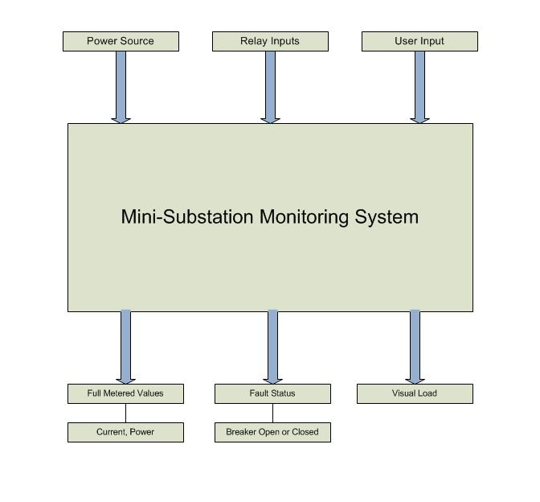
Block Diagram - Inputs and Outputs

Slide 7
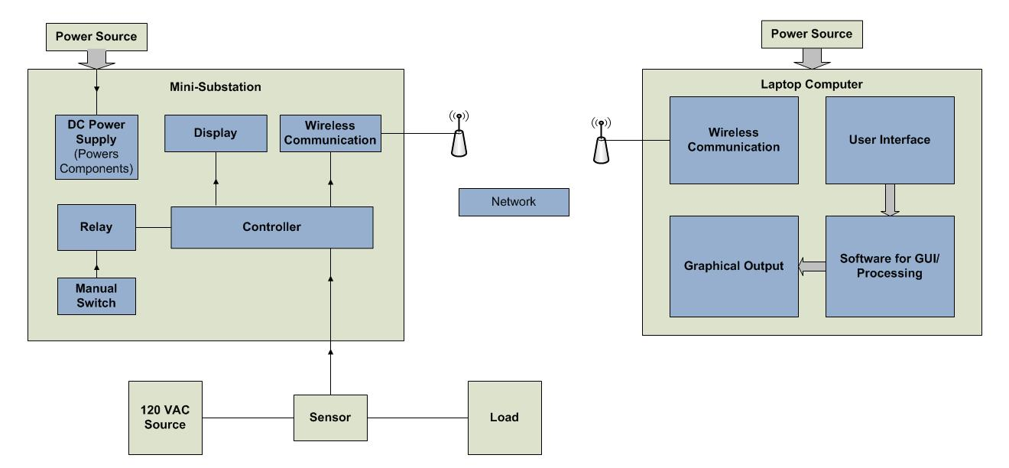
Block Diagram

Slide 8
Microcontroller
Receive data from current sensor
Calculate current and power
Display all data on LCD
Communicate with Xbee
Relay control
Compatible with familiar programming language
Developmental Tools

Slide 9
Microcontroller
PIC18F4550
40 pins
13 ADC inputs
32Kb of Program Memory
Wide Operating Voltage Range: 2V – 5.5V
Internal Oscillator : 31kHz – 8MHz
ATmega168
28 pins
6 ADC inputs
16Kb of Program Memory
Wide Operating Voltage Range: 2.7V – 5.5V
Internal Oscillator : 1MHz – 8MHz

Slide 10
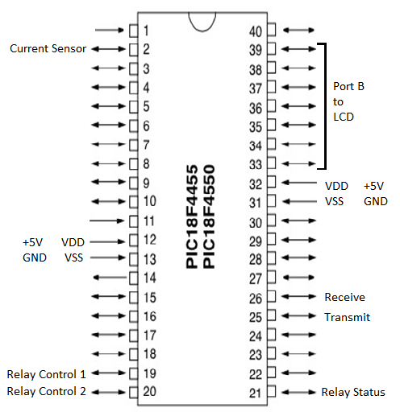
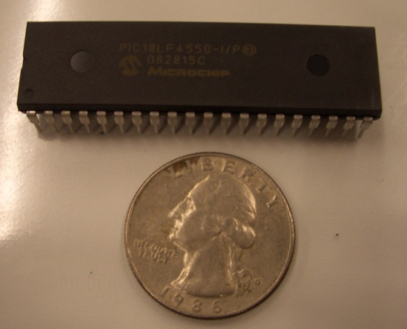
Microcontroller Pin Layout

Slide 11
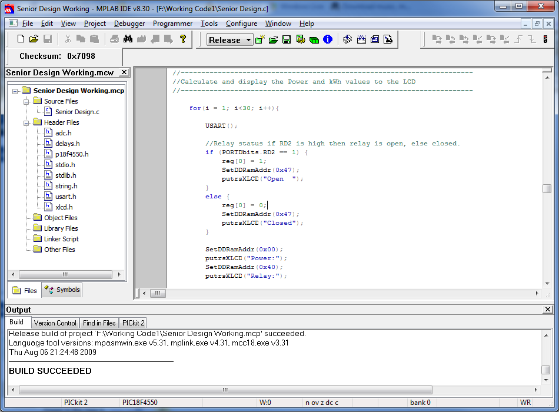
Programming PIC
MPLAB IDE
MPLAB C18 Compiler
PICkit 2 Programmer
C18 Standard Library’s
XLCD.h
OpenXLCD()
SetDDRamAddr()
PutrsXLCD()
USART.h
OpenUSART()
ReadUSART()
PutrsUSART()
ADC.h
Open ADC()
ReadADC()
ConvertADC()
Notes:
Set Display data addres.

Slide 12
Modbus Protocol
A simple protocol data unit (PDU) independent of underlying communication layers.
Modbus is used in many devices such as:
PLC, HMI, Control Panels, Drivers, Motion Controls, and other I/O devices
To control and initiate remote operations.
Can be done on serial interfaces as well as TCP/IP.
We are using Modbus serial to do our communications.

Slide 13
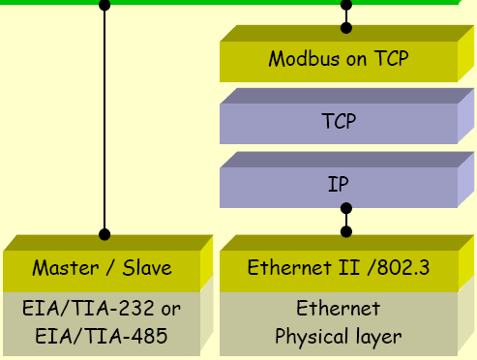
Modbus Communication Stack
Modbus Application Layer

Slide 14
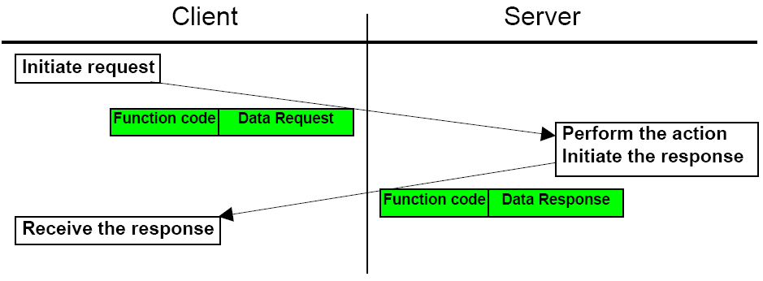
Modbus cont.
Handshake type serial transmission
Modbus Message Transaction

Slide 15
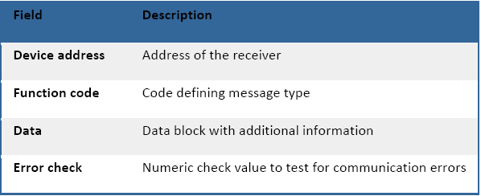
Modbus cont.
Format written in Hex→
Request
usually 8 bytes
A positive Response
The response function code = the requested function code.
An Exception Response
Error detected during processing.
Exception code = requested function code + 0x80h for the reason of the error.
The microcontroller must be programmed to accept the modbus library of functions and error exceptions.

Slide 16
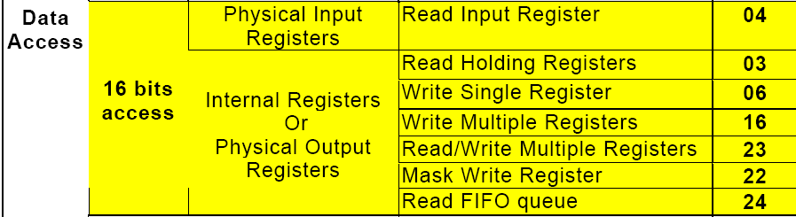
Modbus cont.
Function code 03-Read Holding registers to access the data from our microcontroller.
Function code 06-Write Single Register to wirelessly control and receive the status of the relay.

Slide 17
Wireless communications Specifications
Bi-directional serial communications
3.3 to 5 DC operational voltage
Small form factor < 3”x3”x3” for panel
Small form factor < 2”x2”x2” for computer interface
Data transfer rate minimum of 50Kbps
Effective range of >30 meters

Slide 18
Wireless Options
Bluetooth
Low power, short-range wireless communication operating under the IEEE 802.15.1 standard.
This technology is inexpensive and the form-factor is relatively small.
Bluetooth works in fixed and mobile devices with omnidirectional signal output, operating in the 2.4 GHz short-range radio frequency bandwidth.
Bluetooth is capable of transmission rate of 3Mbits/s.
Effective range of 10 meters.

Slide 19
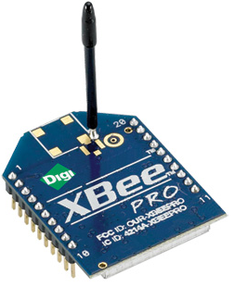
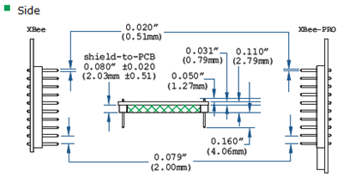
Wireless Options
X-Bee RF module
Small form factor
ZigBee 802.15.4 standard
Decent range (100 meters)
Low power consumption (1 mW)
Data rate of (250 Kbps)
Mesh or point to point
topology
Inexpensive ($19 from digi.com)

Slide 20
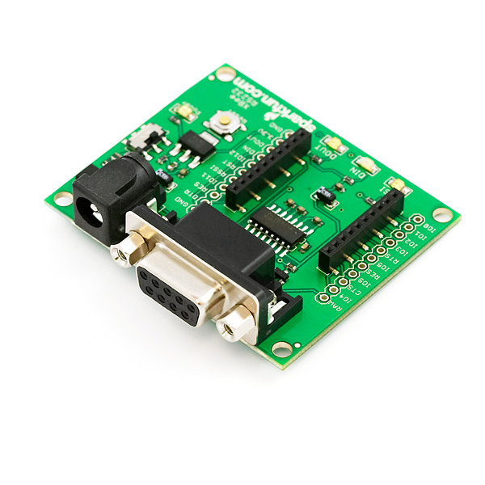
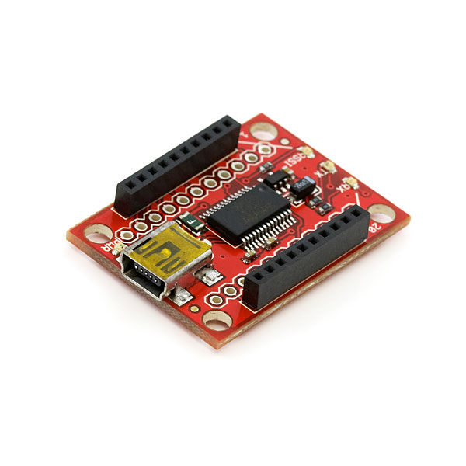
Serial and USB Explorers
Configuration of modules
Testing
Cost of $24 from Sparkfun.com

Slide 21
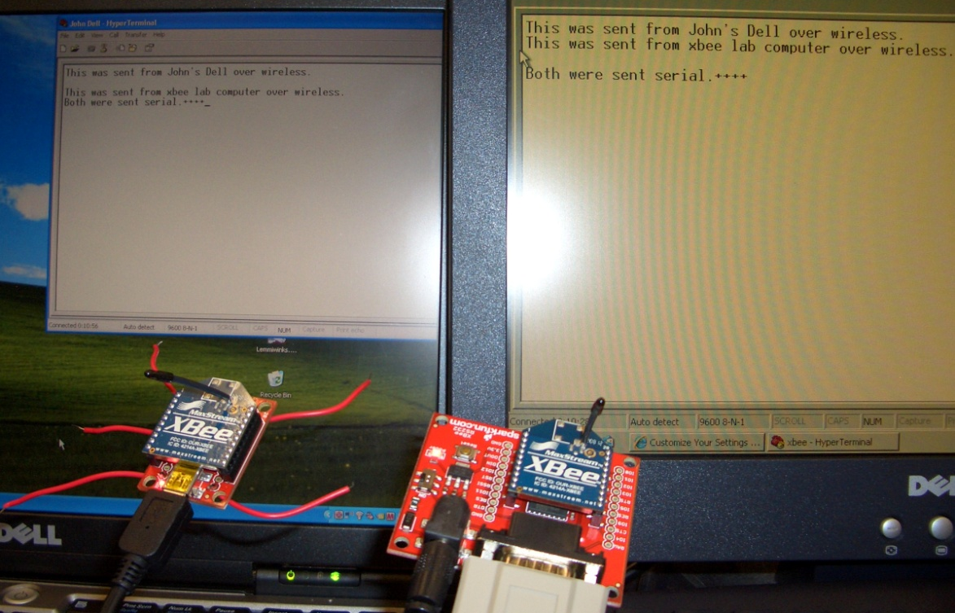
Testing of X-Bee Modules
Computer to computer test
HyperTerminal
Two X-Bee modules using RS232 and USB explorers

Slide 22
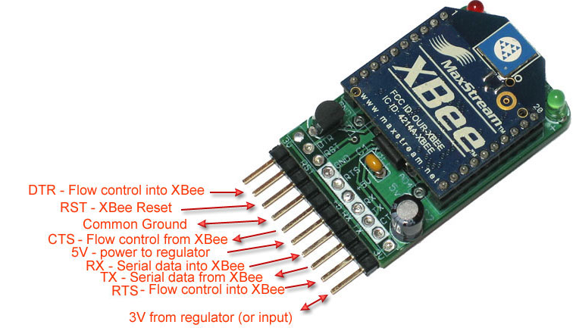
X-Bee Adapter Kit
Connects via USB with FTDI cable
Onboard voltage regulator
LED status lights
Cost of $10 from Adafruit Industries

Slide 23
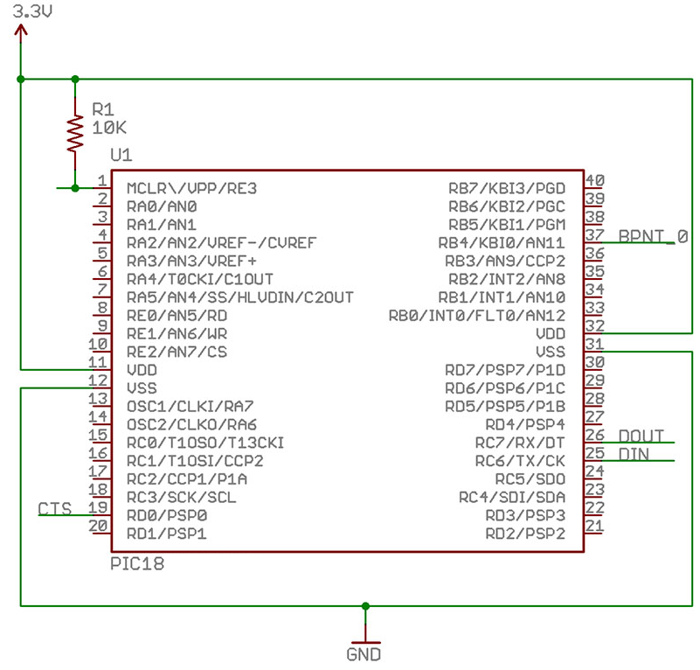
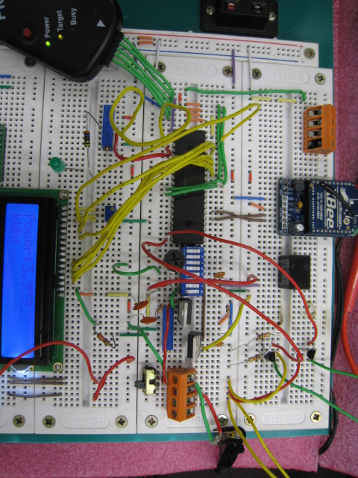
Integrating with PIC
Using USB Explorer and stand-alone module and HyperTerminal.
Message echoing.

Slide 24
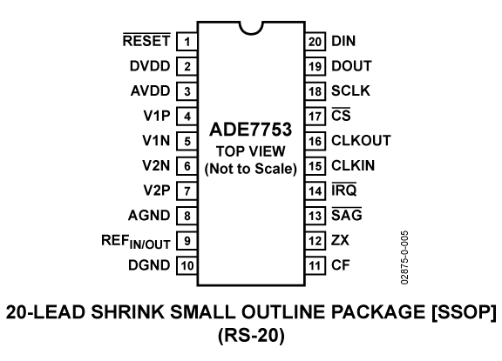
Energy Meter
ADE7753
Single Phase
Voltage and current sensor inputs
Active, reactive, and apparent energy measurements, rms calculation on the voltage and current.
Serial interface

Slide 25
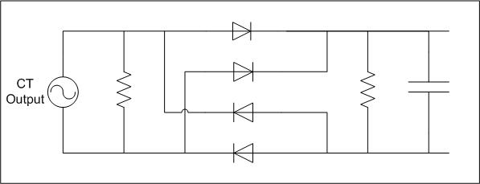
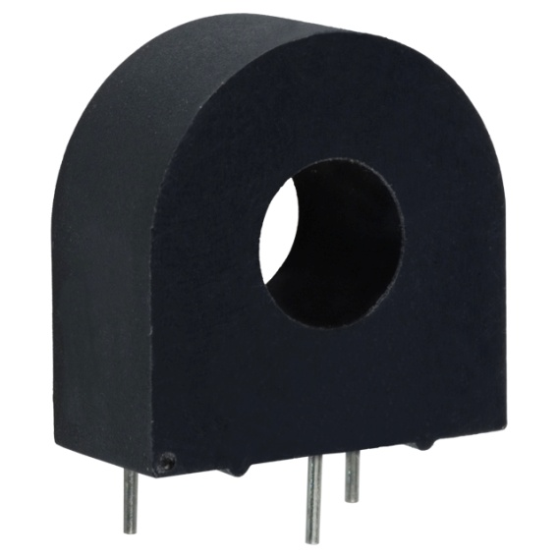
Current Sensor
Current Transformer
AC1020
Low Cost
Mount Type: PCB
50Hz - 60Hz
Current Rating: 20A
Output will be converted to DC for input into the microcontroller
AC to DC Rectifier

Slide 26
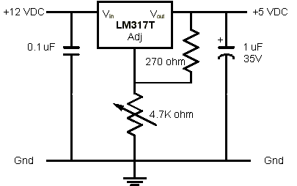
Power Supply
12VDC to 5VDC
LM317T
Variable voltage
regulator
10K potentiometer for adjusting the output voltage
Capacitors to reduce voltage ripple

Slide 27
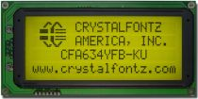
LCD Choices
411 Technology Systems model: SSC2F16DLNW-S
Cost was $8.00
Features:
16 X 2 Display
Dimensions:
3.13”(W) X 1.42”(H) X 0.53” (D)
4-bit or 8-bit parallel interface
Standard Hitachi HD44780
equivalent controller
Crystal Fontz model: CFA634-YFB-KU LCD (20*4)
About $65.00
Features:
20 X 4 Display
Dimensions:
5.12”(W) X 2.48”(H) X 0.78” (D)
4-bit or 8-bit parallel interface

Slide 28
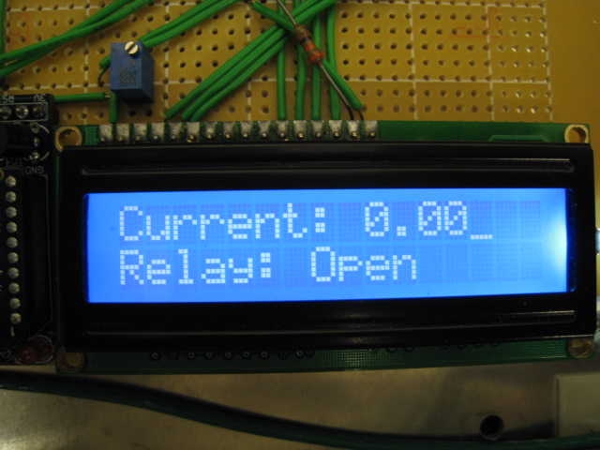
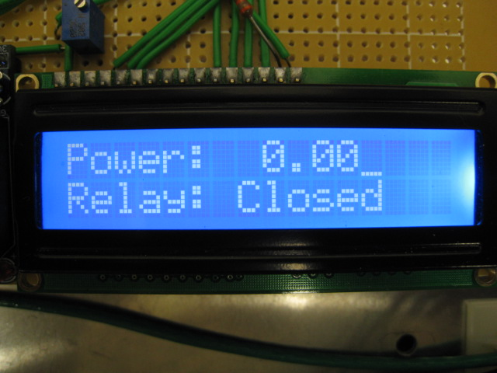
Liquid Crystal Display
We programmed the LCD to have two screens.
Relay status is on both screens.
Power and current alternate screens.

Slide 29
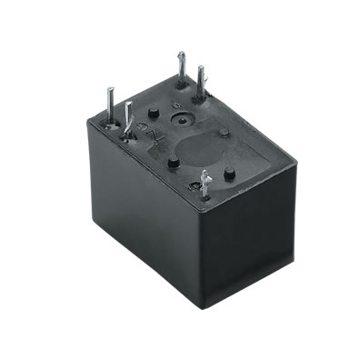
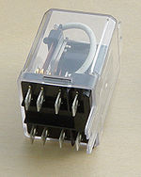
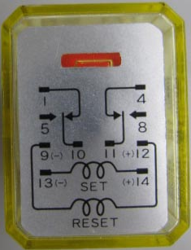
Relay
We are using a relay as an electrical switch that opens and closes under the control of our circuit.
The relay will act as an overload device.
The microcontroller is programmed to send a signal to trip the relay.

Slide 30
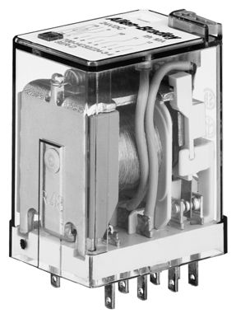
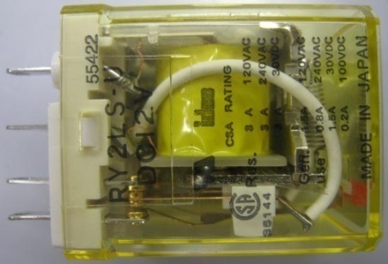
Relay Choices
RY2LS-U Relay
It’s a small industrial GP signaling relay
Ice cube packaging
Minimum load of 10mA at 5 volts
Consumes small amount of power
RR2BA-UDC6V
Ice cube packaging
Coil rating of 6VDC
8 weeks to manufacture so we decided to go with the 12V

Slide 31
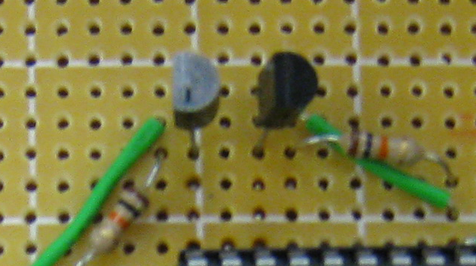
Transistor Switches
In order to use our 12 volt relay we needed a way to switch it with the microcontroller.
N- Channel: 2n5458
Transistors are commonly used as electronic switches
We are using the transistor to pass the -12 volts to trip the relay

Slide 32
SCADA - ClearScada
High level Industrial software
Integrated Development environment using an Object Oriented database of information
Allows us to create an easy to use graphical interface.
Create all analog and digital points to be monitored.
Configure alarm limits to trip the breaker on an over-current condition or manually with the scripts written for the breaker buttons.
Difficult problem: connecting high level industry standard software back to small circuit design.
Software Demo License courtesy of BCI Technologies. (free)

Slide 33
SCADA cont.
The software is a development environment much like LabVIEW or Visio.
It must be customized, configured and programmed to your specific need or application.
It can be configured and programmed in a few different ways.
Scripting to run behind the buttons, so when they are pressed it will set the object to 1 or 0.
Structured Text Program – similar to a C program, our use is to write a 1 or 0 to the relay status register.
Function Block-our use is to break up to get the high byte or the low byte of an address or piece of information passed in.

Slide 34
SCADA cont.
C# Application
Connects communication of our Xbee to ClearSCADA.
Brings our monitored values including current, power, relay status into ClearSCADA.
Allows us to communicate back to our panel in order to wirelessly open and close our relay.

Slide 35
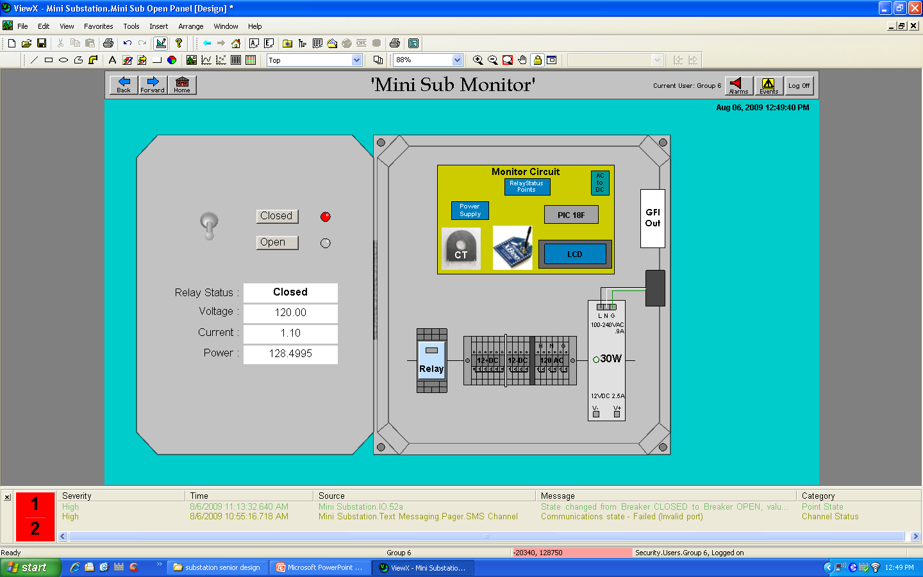
Panel in ClearSCADA Environment

Slide 36
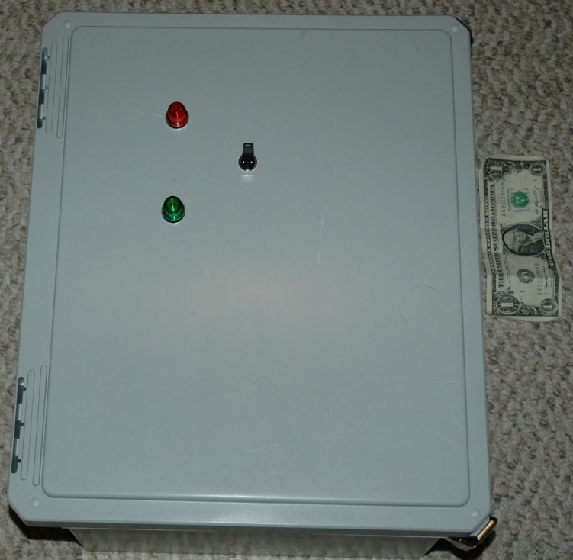
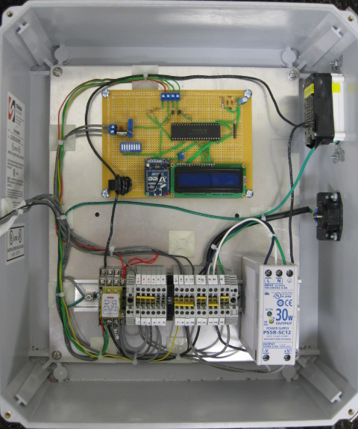
Actual Panel
Stahlin Non-Metallic Enclosure
16x14x8 in Temp. Rating: -40˚ F to 250 ˚ F
Nema 4x rating Industrial Grade
Cost $57 but donated by BCI Technologies

Slide 37
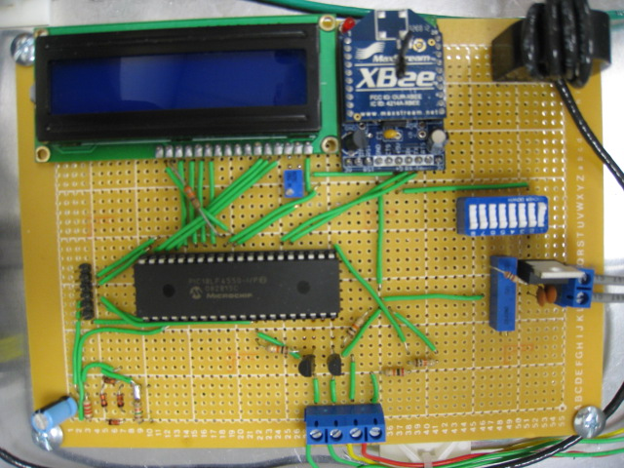
Circuit Board Layout

Slide 38
Work Distribution

Slide 39
Project Budget
Mini-Substation Monitoring System Cost
Parts | Development Cost | Actual Cost
Panel enclosure | $58.00 | $58.00
alum. Backplane | $6.00 | $6.00
12V latching relay | $25.00 | $25.00
5V relay | $5.00 | $0.00
PCB board | $65.00 | $30.00
xbee wireless chip x2 | $50.00 | $50.00
Xbee Serial board Explorer | $25.00 | $25.00
Xbee wireless adapter | $25.00 | $25.00
PIC microcontroller | $5.00 | $0.00
Current Transformer | $7.00 | $7.00
LCD Screen | $8.00 | $8.00
alarm circuit | $10.00 | $10.00
Minimum software license | $1,200.00 | free demo
12VDC Power Supply | $77.00 | donated
Test Load | $20.00 | $0.00
red and green lights | $3.00 | $3.00
terminal blocks | $5.00 | donated
wire | $10.00 | donated
GFI Outlet | $12.00 | $12.00
Small Components
Res, Trans, Caps | $10.00 | $10.00
dinrail | $7.00 | $7.00
Time and Effort | Priceless
Totals | $1,633.00 | $276.00
Some of our parts were donated by BCI Technologies.
Our total project cost was $276.00.

Slide 40
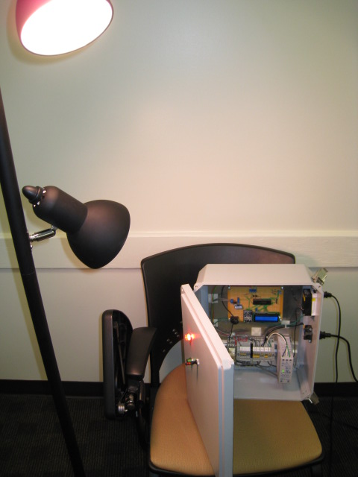
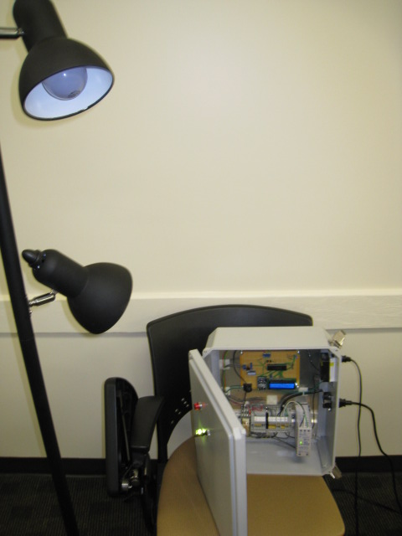
Final Product - Testing
Relay Closed
Relay Open

Slide 41
Questions

